Slide 1
RAG
Akshay Parate

Slide 2
What is RAG ?
RAG which stands for Retrieval Augmented Generation, is a technique that enhances the accuracy and relevance of responses generated by large language models (LLMs) by allowing them to access and incorporate information from external knowledge bases, essentially providing more up-to-date and context-specific answers to queries.
Benefits:
Improved accuracy
Domain-specific expertise
Up-to-date information
Applications:
Customer service chatbots
Knowledge management systems
Research and analysis
Notes:
The system retrieves relevant information or documents from a database, knowledge base, or external sources (e.g., search engines or custom datasets). This ensures the model has access to up-to-date or specific data.

Slide 3
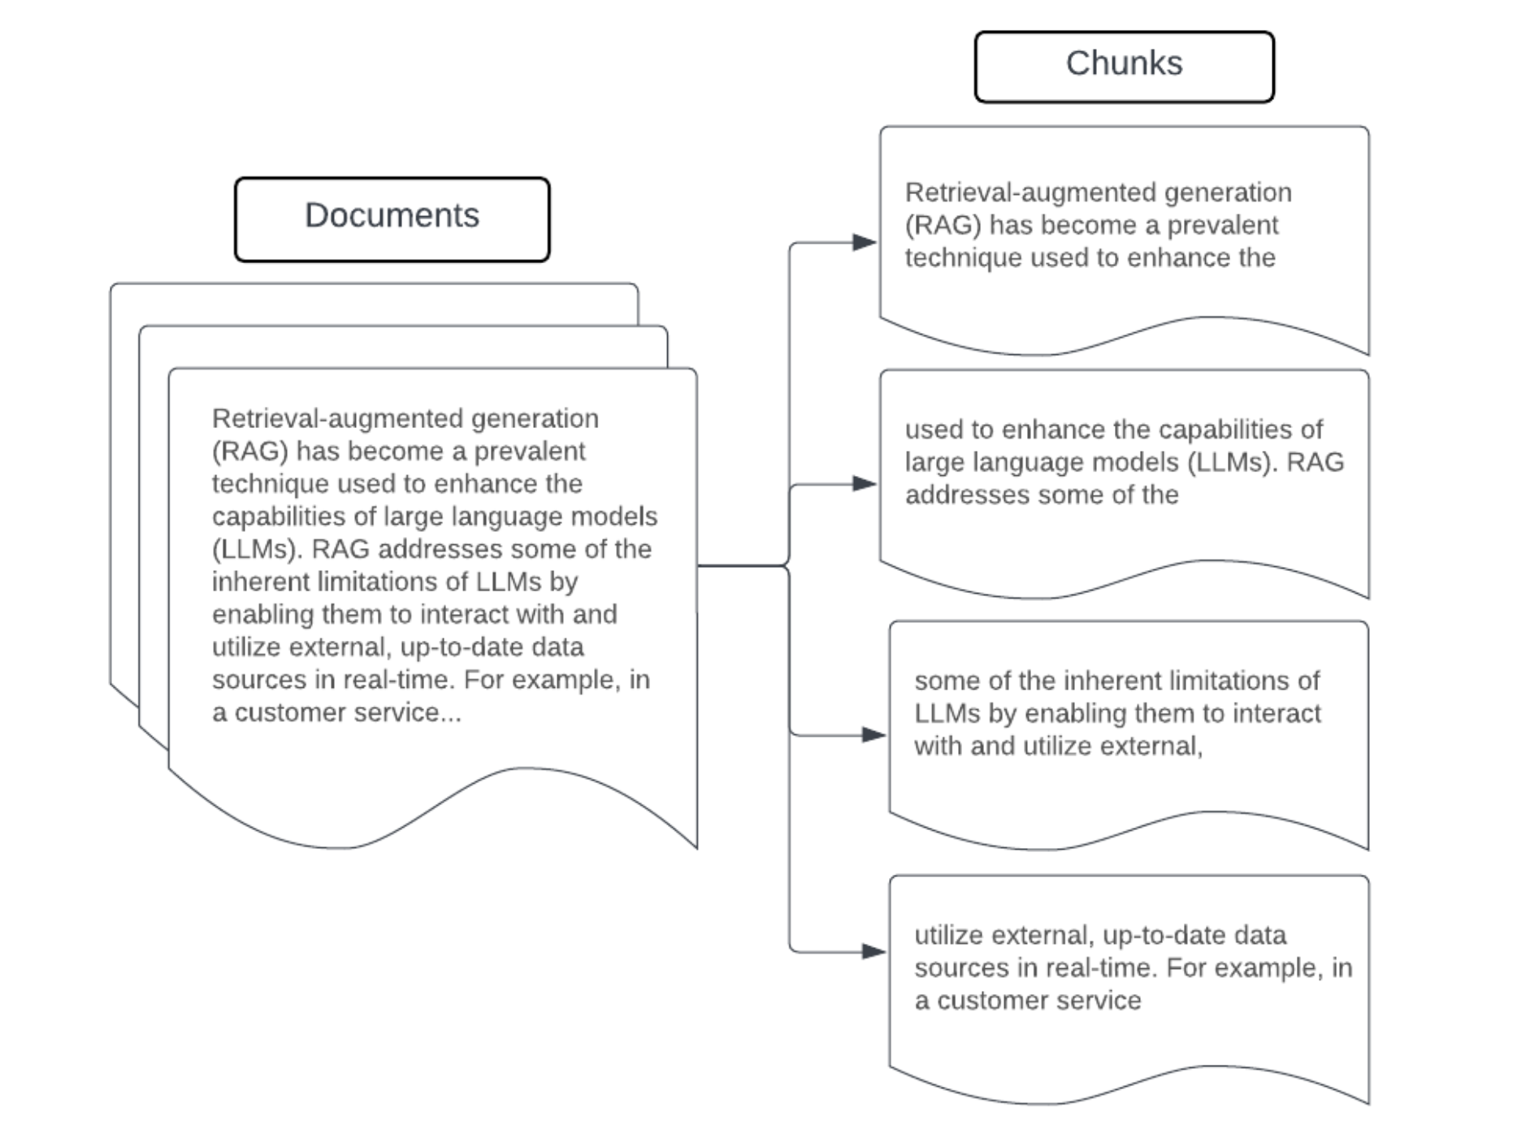
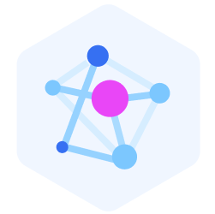
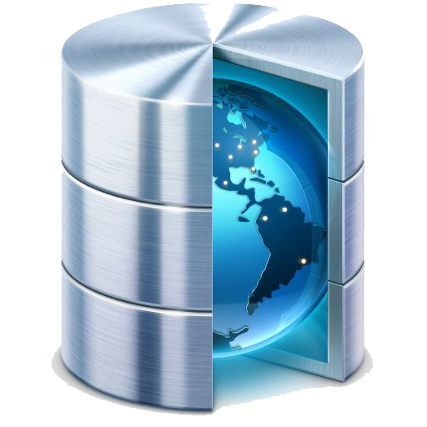
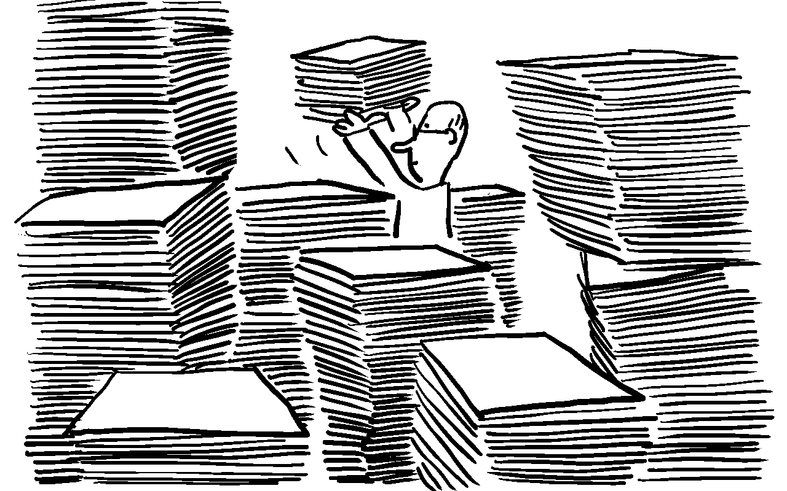
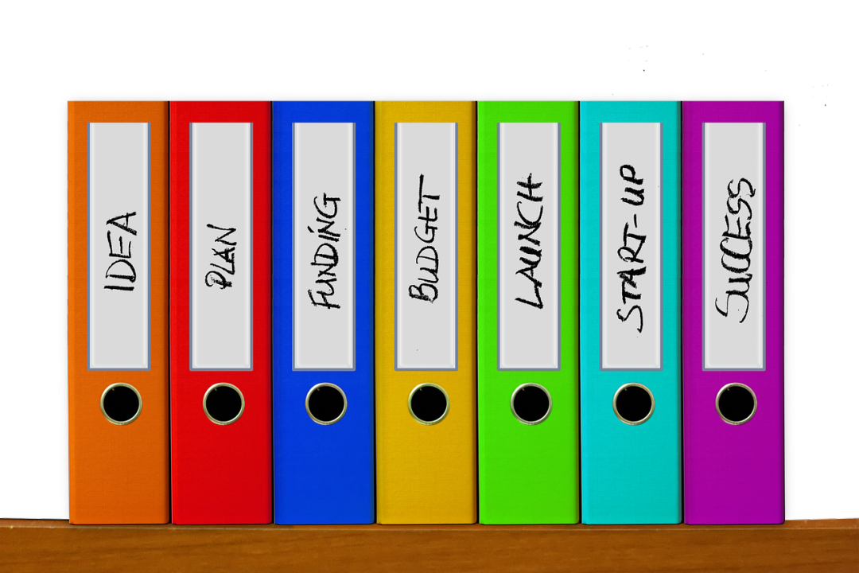
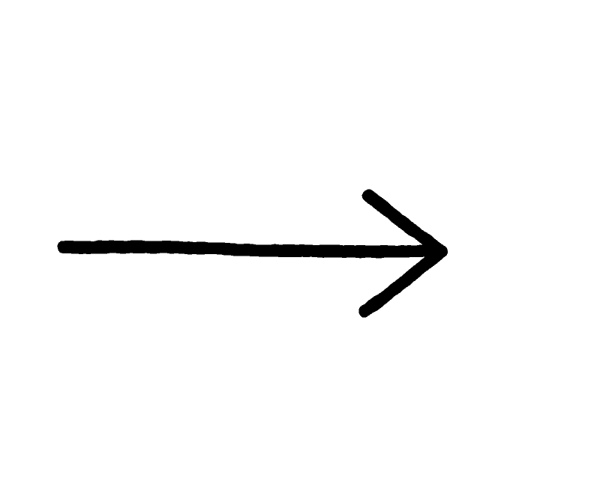
How the RAG Ingestion pipeline works?
Tons of unstructured data
Chunks of data
Vector Embeddings
Vector Database
Notes:
How the RAG Ingestion Pipeline Works? The ingestion pipeline takes unstructured data and prepares it for future retrieval.
This refers to raw data like text files, articles, or documents that lack a predefined structure.
The unstructured data is split into smaller, more manageable chunks. This makes it easier to process and retrieve relevant information during the generation phase.
Each chunk is transformed into a numeric vector representation (embedding) using a model such as BERT. These embeddings are key to comparing and retrieving relevant information, as they capture the semantic meaning of the text.
Vector Database: These embeddings are then stored in a vector database. This specialized database enables fast and efficient retrieval of similar vectors based on a given query.You can think of it as if you had a large collection of news articles, the ingestion pipeline would break each article into smaller sections, convert them into vectors using an embedding model, and store them in a vector database. Later, a query like "latest news on climate change" would retrieve the most relevant sections based on the vector similarity.

Slide 4
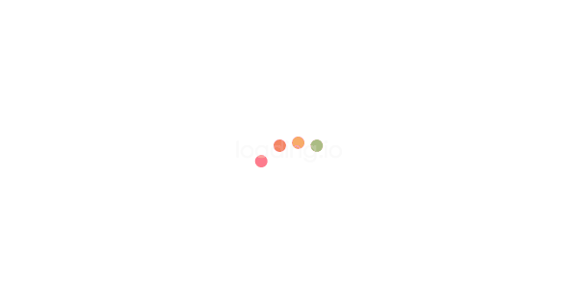




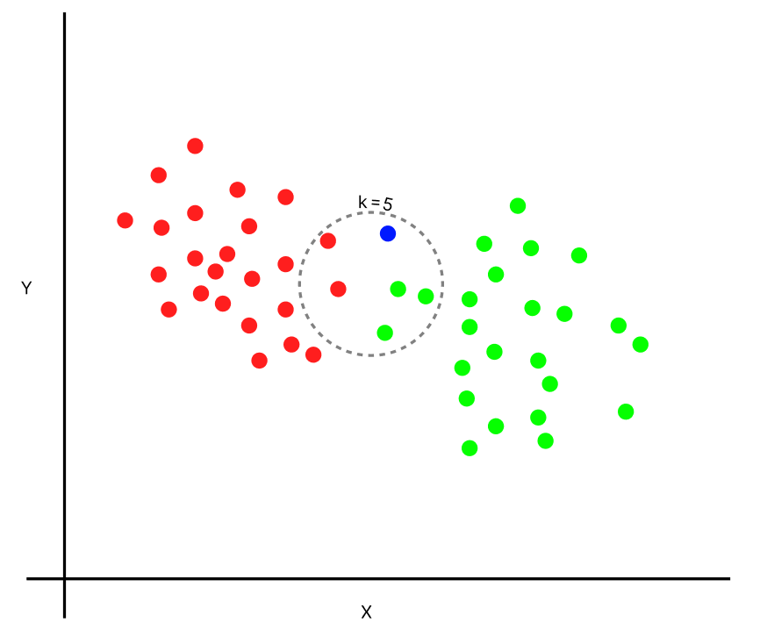
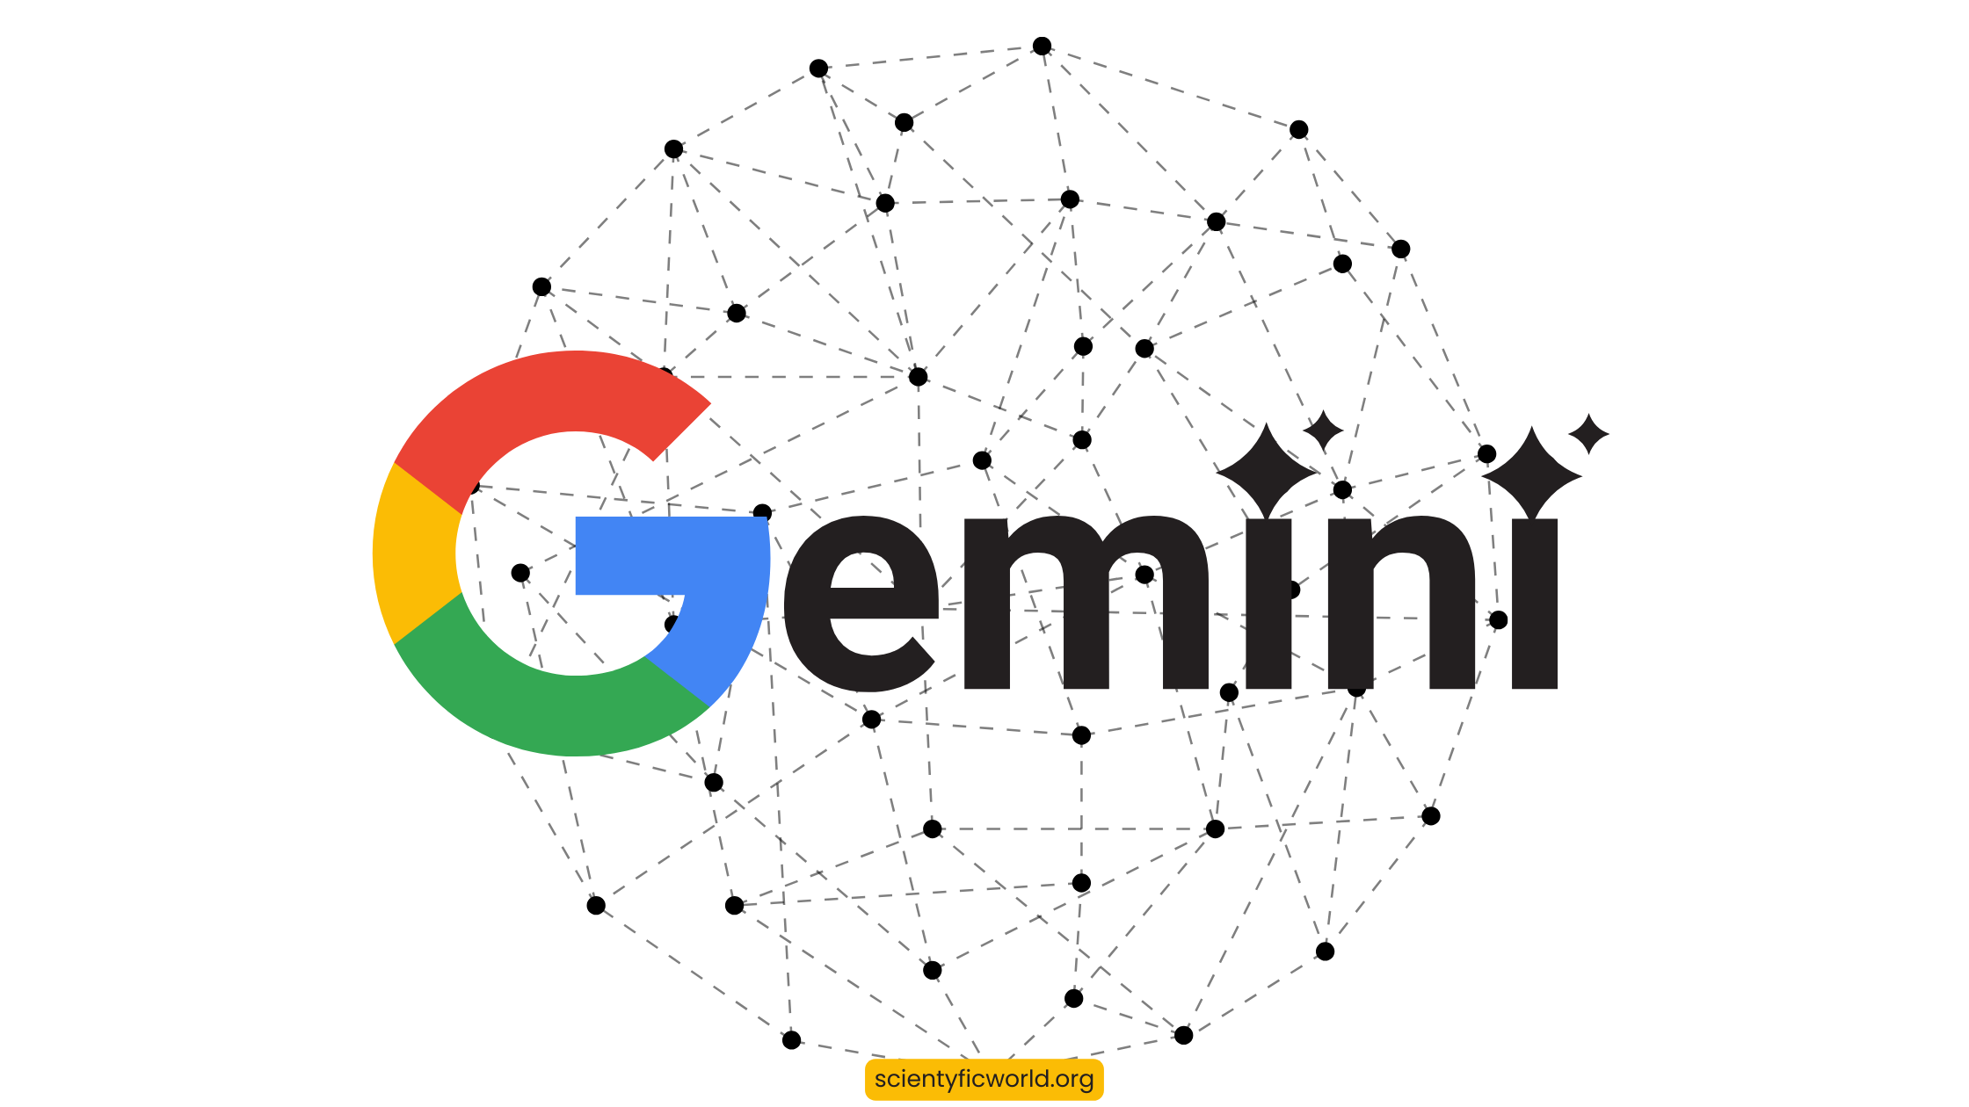

How the RAG Retrieval pipeline works?
User Query
Embedding Models
Vector Database
Vector Similarity
K Documents
LLM
Notes:
A user query or question is input into the system.The query is converted into an embedding and sent to the vector database to retrieve the top N most similar chunks of data.These retrieved chunks are passed to a language model, which generates a response using the retrieved information.lets say if a user asks, "What is machine learning?", the naive RAG would retrieve relevant chunks from the vector database (such as definitions, explanations from articles), and then generate a detailed answer by combining those chunks.

Slide 5
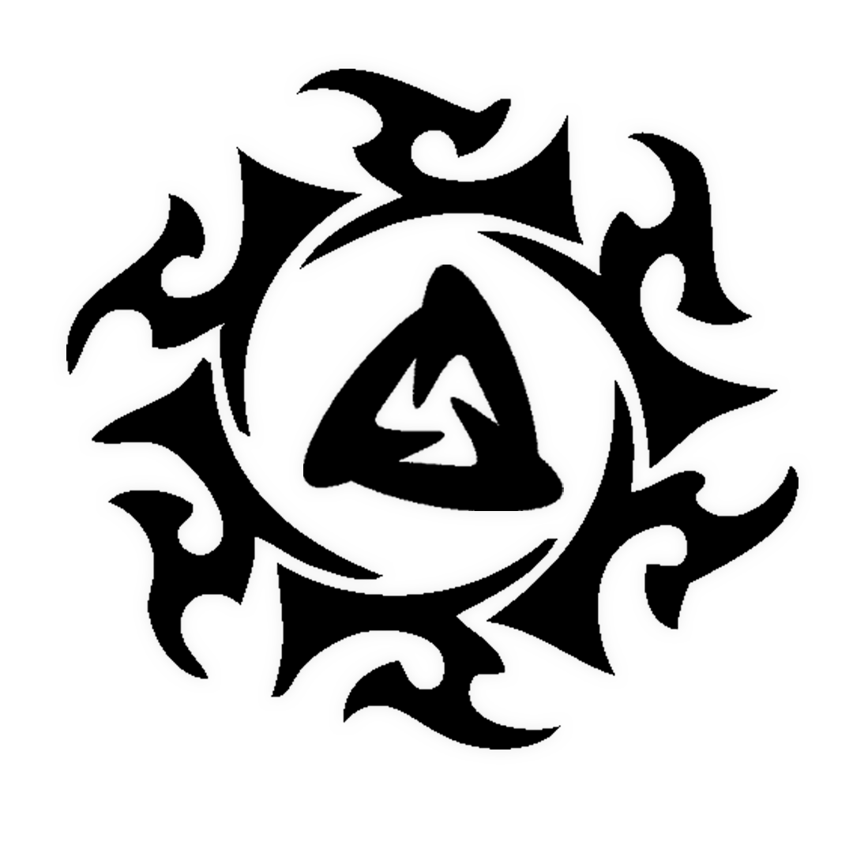
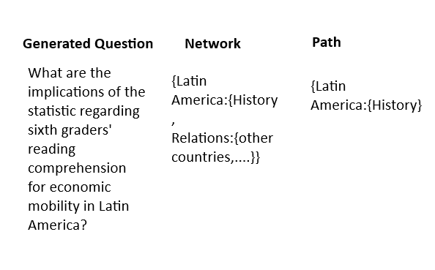
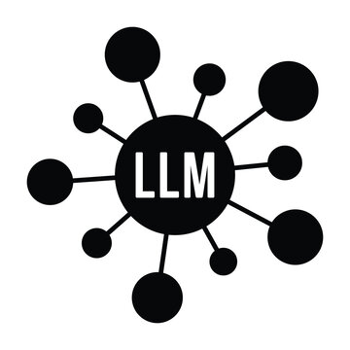
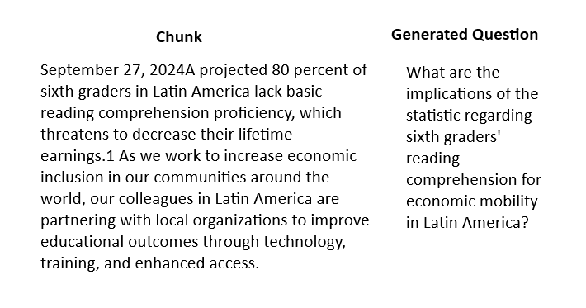
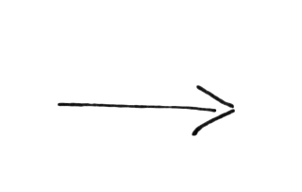
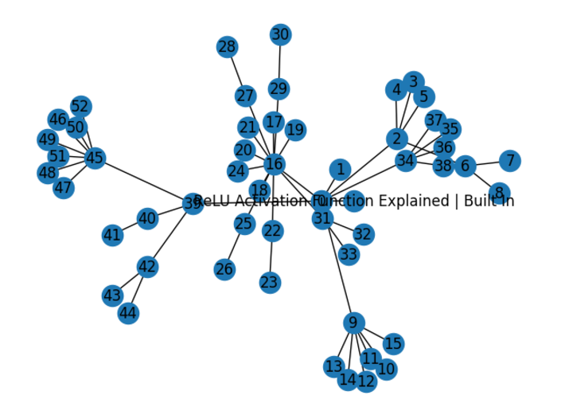
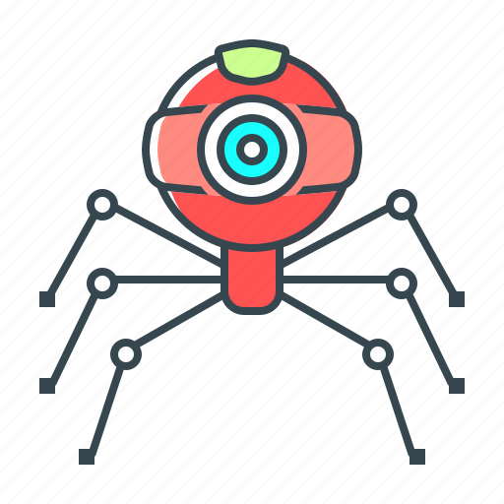
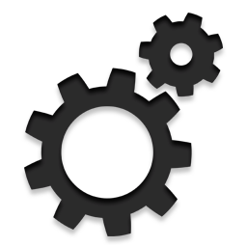
REALM : Retrieval Augmented Language Model
Data Generation
LLM
Web Crawler
Network Graph
Notes:
Realm stands for retrieval augmented language model. For now lets remember realm as LLM Agent which provides us the correct path to the destination. Just like google maps.
This is a part of advanced rag system which uses network graph to retrieve the relevant chunks by predicting the path.
First lets discuss how I trained this LLM Agent. To train this model, the dataset is not available online, so I have to scrape the data and transform it.
So I developed a web crawler which basically scrapes the data continuously until it is stopped. This scrapped data is converted to network graphs using python and pyspark.
This network graph is given to the existing LLM whose only purpose is to generate answers based on chunks provided to it. So we will provide the leafs from the last stage of the network to LLM agent which are basically paragraphs and LLM Agent will provide the questions. Since we are the one who has created the network, we know the path to that chunk in the network. We transofmr the data such that independent variables will be question and network and target variable will be path.
As I said earlier think of realm as google maps which will provide you the correct path in the network.

Slide 6
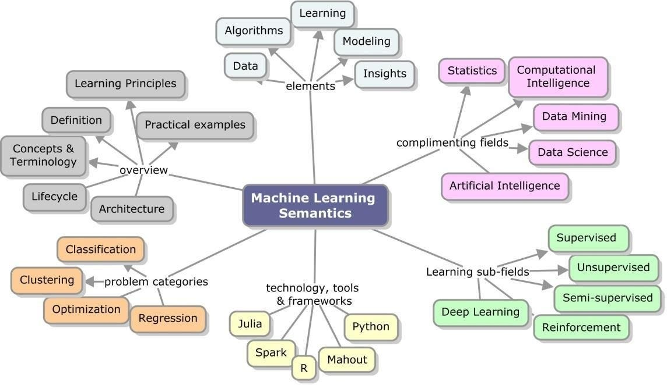
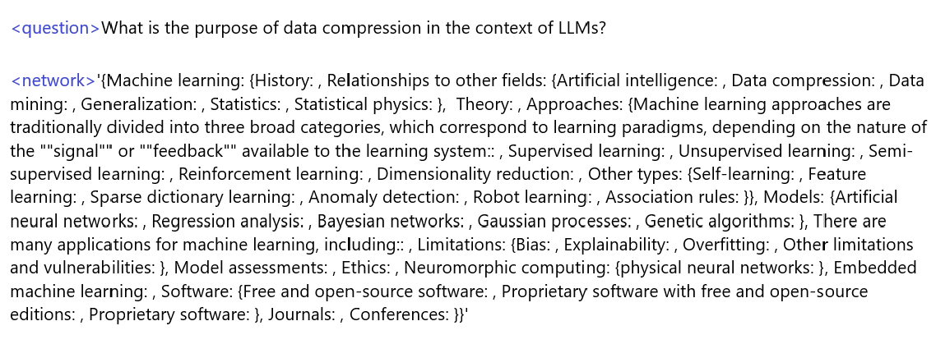
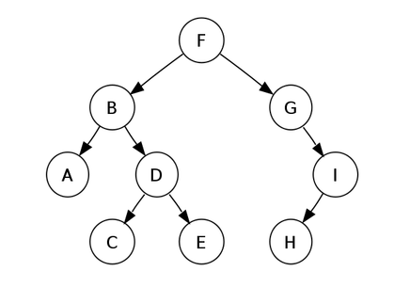


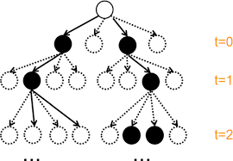
RAPTOR : Recursive Abstractive for Tree Organized Retrieval
Network Graph
User Query + Network
'Machine learning->Relationships to other fields->Data compression'
PDF / Website
REALM
Path Predictions
Notes:
Now this is the main architecture of the RAG.
Whenever use provides a query to the main LLM, we will scrape the data from information source. Here it can be a pdf or a website.
This pdf or a website will be converted to the network graphs based on the tags or size.
This network graph along with the user query will be given to the realm (LLM agent which was trained to predict the path).
Realm will predict the path using the user query and network.
And the contents below that predicted path will be retrieved.
So this was no information will be lost and we can retrieve not just text by images, gif or videos as well.
So it will be like you are watching a youtube tutorial video
Currently I have over 1000s of different tags due to which the REALM is not able to predict the path with higher accuracy. But soon I will be using limited number of tags and will generate network graphs based on it. I am expecting 80-90% accuracy once it is implemented. Current market accuracy for REALM is 58%.

Slide 7
Advantages Over Vanilla RAG
Context Tracking and Detailed Explanations : Graph/tree-like structure ensures seamless context retention and enables comprehensive explanations without skipping topics (common in Vanilla RAG).
Multimodal Context Awareness : Tracks and integrates code or images within the document enhances explanations, akin to an interactive video experience.
Reduced Hallucination : Improves factual accuracy by leveraging structured context and reducing reliance on assumptions.
Enhanced Scalability : Efficiently handles large and complex datasets with better organization and retrieval capabilities.
Improved Query Understanding : Adapts to user-specific queries by dynamically navigating the graph structure for tailored responses.
Notes:
One of the biggest advantages of this RAG architecture is, there is no information loss. As we know in vanilla rag we cant keep track of the information which means we are not sure if the retrived chunk has complete information or not. But using this network graph technique we can keep track of the chunks and also can provide any image or code as well. I will show you the demo in the next slide.

Slide 8
